Slide 1

BCA Semester V • Machine Learning
Core Machine Learning Concepts
A visual, foundational walkthrough of PAC Learning, Noise, Multi-Class Learning, Regression, and Generalization.
Pedagogical Focus
Scope
Intuitive explanations, minimal math, zero derivations.
5 key syllabus modules designed for classroom clarity.

Slide 2
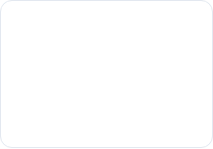
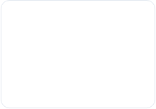
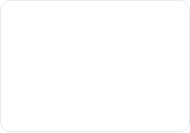
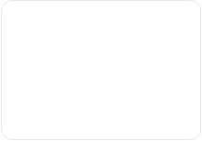





LECTURE OUTLINE
Five Core Machine Learning Topics
PAC Learning
Noise
Multiple Classes
Regression
Generalization
Probably Approximately Correct framework
Imperfect labels, features & hidden factors
One-vs-Rest vs. One-vs-One strategies
Predicting continuous numerical outcomes
Overfitting, validation & bias-variance
Speaker Notes for Teacher: "Welcome class! Today we cover the foundation of Machine Learning from Unit-I. We will look at 5 intuitive building blocks. You don't need complex math—just follow the logic of how a computer learns from data."

Slide 3


SECTION 1 • PAC LEARNING
What is PAC Learning?
+
WORD 1
WORD 2
Probably
Approximately Correct
High chance the learned model is successful.
Small tolerable error on unseen samples.
Speaker Notes for Teacher: "Explain the acronym: PAC = Probably Approximately Correct. Ask students: 'Can a machine be 100% right on future data?' No! So we aim for two guarantees: (1) High probability of working well ('Probably'), and (2) Very low error rate ('Approximately Correct')."

Slide 4
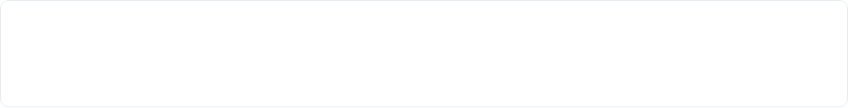




SECTION 1 • PAC LEARNING
The Learning Workflow in PAC
Training Data
Algorithm
Learned Model
New Email
Past emails (Spam / Ham)
Finds rules & patterns
Spam classifier filter
Accurate classification
Spam Filter Example: Out of 100 new emails, filtering 98 correctly (≤ 2% error) with 99% reliability means the model is PAC-learned.
Speaker Notes for Teacher: "Walk through the 4 steps left-to-right. Give the spam filter example: You don't need 100% perfection. If your spam filter catches 98 out of 100 spam emails, that small 2% error is completely acceptable in practice."

Slide 5
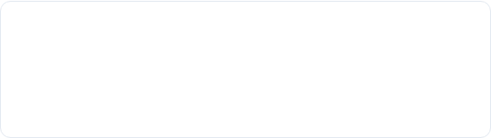
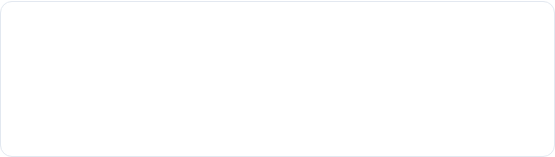
SECTION 1 • PAC LEARNING
Understanding ε (Epsilon) and δ (Delta)
ε
δ
Error Parameter (Epsilon)
Failure Parameter (Delta)
How much mistake is tolerated.
Risk of drawing bad training sample.
Rule: With probability ≥ (1 - δ), Model Error ≤ ε
Speaker Notes for Teacher: "Students often fear Greek symbols. Tell them: Epsilon (ε) is just your budget for error (like 5%). Delta (δ) is the chance of bad luck (like 1%). So 1-δ is your 99% confidence. Reassure them: No derivations required, just the intuitive meaning."

Slide 6
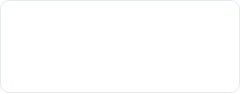
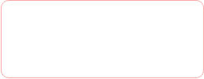
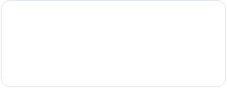
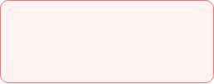
SECTION 2 • NOISE IN MACHINE LEARNING
What is Noise?
"Noise is unwanted, incorrect, or misleading information present in the dataset."
STEP 1
STEP 2
STEP 3
RESULT
Clean Data
Noise Injected
Harder Learning
Wrong Output
True underlying patterns
Typos, faulty sensors
Model gets confused
Poor future accuracy
Speaker Notes for Teacher: "Define noise simply: Any error or distortion in the data. Compare it to static on a radio channel: When static enters the radio, you can't hear the song clearly. Similarly, when noise enters data, the algorithm struggles to find the true pattern."

Slide 7









SECTION 2 • NOISE IN MACHINE LEARNING
Three Common Sources of Noise
1. Feature Noise
2. Label Noise
3. Hidden Factors
Errors in measured inputs (x).
Wrong teacher annotations (y).
Unobserved critical variables.
Speaker Notes for Teacher: "Highlight the 3 sources: Feature noise (bad measurement like faulty thermometer), Label noise (human error during data tagging), and Hidden factors (missing information that wasn't recorded). Students must know all three."

Slide 8
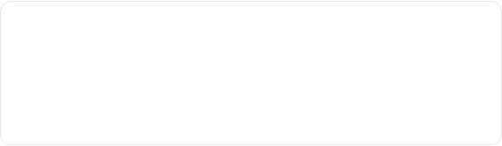
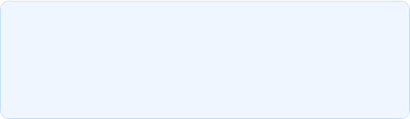
SECTION 2 • NOISE IN MACHINE LEARNING
Why is Noise a Major Problem?
Key Consequences
Golden Rule for Students
•
Over-complexity: Model invents weird rules to fit noisy points.
A simple model that ignores noise is far superior to a complex model that tries to explain every single error point.
•
Memorization: Model learns random errors instead of patterns.
•
Poor generalization: Fails when tested on clean, real-world data.
→ Simplicity prevents overfitting to noise!
Speaker Notes for Teacher: "Emphasize this core takeaway: If you force your algorithm to get 100% training accuracy on noisy data, it will memorize the mistakes. It's like a student memorizing typo errors from a notebook instead of understanding the concept."

Slide 9







SECTION 3 • LEARNING MULTIPLE CLASSES
Binary vs. Multi-Class Classification
SCENARIO A
SCENARIO B
Binary Classification
Multi-Class Classification
Only 2 possible outcomes.
3 or more distinct classes (K ≥ 3).
Examples: Spam vs Not Spam • Pass vs Fail
Question: How do we solve this using simple 2-way classifiers?
Speaker Notes for Teacher: "Start by asking: 'So far we classified Yes or No. But what if we want to classify an animal into Cat, Dog, or Bird?' Explain that most basic algorithms are built for 2 classes. To handle 3 or more classes, we use two simple strategies: One-vs-Rest and One-vs-One."

Slide 10
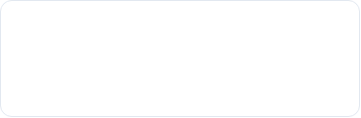
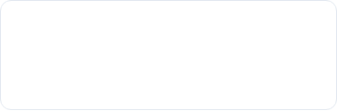
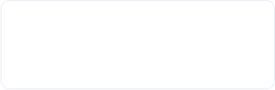
SECTION 3 • LEARNING MULTIPLE CLASSES
Strategy 1: One-vs-Rest (OvR / One-vs-All)
Cat vs. [Dog + Bird]
Dog vs. [Cat + Bird]
Bird vs. [Cat + Dog]
Is it a Cat or NOT a Cat?
Is it a Dog or NOT a Dog?
Is it a Bird or NOT a Bird?
Formula for Number of Classifiers: Total Classifiers = K (where K = number of classes)
Speaker Notes for Teacher: "One-vs-Rest trains one binary classifier per class. Each classifier separates one specific class from all other classes combined. The class with the highest prediction score wins. For K classes, we need exactly K classifiers."

Slide 11
SECTION 3 • LEARNING MULTIPLE CLASSES
Strategy 2: One-vs-One (OvO)
Cat vs. Dog
Cat vs. Bird
Dog vs. Bird
Ignores Bird data completely
Ignores Dog data completely
Ignores Cat data completely
Formula: Total Classifiers = K × (K - 1) / 2 • Majority voting decides winner
Speaker Notes for Teacher: "In One-vs-One, we organize a tournament. Every pair plays a match against each other. Each classifier votes for one class, and the class with the most votes wins. If we have 4 classes, we need 4*(3)/2 = 6 classifiers."

Slide 12


SECTION 4 • REGRESSION
Classification vs. Regression
TASK 1
TASK 2
Classification
Regression
Predicts a discrete category / label.
Predicts a continuous numerical value.
•
Spam vs. Not Spam
•
House Price ($350,000)
•
Cat vs. Dog
•
Tomorrow's Temperature (28.5°C)
•
Pass vs. Fail
•
Employee Salary ($65,000/yr)
Speaker Notes for Teacher: "Make the distinction crystal clear: Classification gives a category ('Is this email spam? Yes/No'). Regression gives a continuous number ('What will the price of this house be? $350,000'). Ask students to name other examples of numbers we might predict."

Slide 13

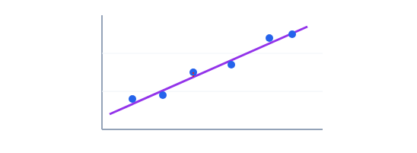

SECTION 4 • REGRESSION
Linear Regression Example: House Prices
Blue Dots (Data)
Known house size and selling price.
Purple Line (Best Fit)
Straight line that passes closest to all dots.
← Small Size (sq ft) Large Size (sq ft) →
Speaker Notes for Teacher: "Point at the graph: The horizontal axis is House Size (Input x), and the vertical axis is Price (Output y). Our goal in regression is simply to draw the best straight line through these points so we can predict the price for any new house size."

Slide 14

SECTION 4 • REGRESSION
The Linear Model: y = wx + b
Straight line equation learned by the computer
x
w
b
y
Input Feature
Weight / Slope
Bias / Intercept
Prediction
House size (sq ft)
Price increase per sq ft
Base minimum price
Estimated total price
Speaker Notes for Teacher: "Break down y = wx + b using simple terms: x is what we give the model (house size). w is the slope (how much price jumps per square foot). b is the base starting price. The model adjusts w and b during training to make errors as small as possible."

Slide 15
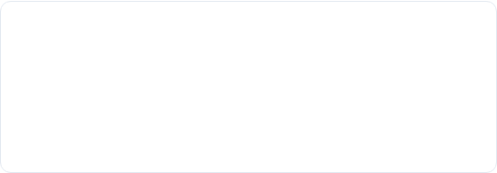
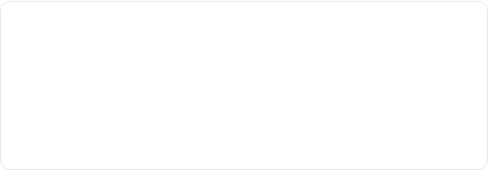
SECTION 5 • MODEL SELECTION & GENERALIZATION
Model Selection and Generalization
CONCEPT 1
CONCEPT 2
Model Selection
Generalization
"Choosing the best algorithm and settings (hyperparameters) for a given problem."
"The ability of a model to perform accurately on completely new, unseen future data."
Speaker Notes for Teacher: "Ask students: 'If a student scores 100% on textbook homework by copying solutions, will they score 100% on a surprise final exam?' No! That ability to solve new surprise questions is Generalization. Model selection is choosing the best student strategy."

Slide 16






SECTION 5 • MODEL SELECTION & GENERALIZATION
The 3 Fitting States
Underfitting
Good Fit
Overfitting
Misses the core trend. High training error.
Captures true pattern smoothly.
Memorizes noise. Fails on new data.
Speaker Notes for Teacher: "Show the three graphs: Underfitting is when the model is too dumb/simple (like a flat line for a curve). Overfitting is when the model is overly complex and squiggles through every noise point. Good fit balances both."

Slide 17
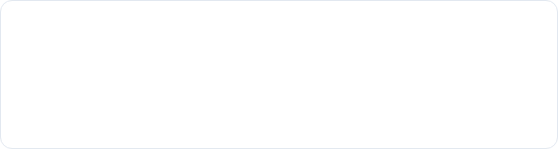



SECTION 5 • MODEL SELECTION & GENERALIZATION
The Bias-Variance Tradeoff
Bias (Underfitting Error)
Variance (Overfitting Error)
Wrong assumptions made by the model.
Extreme sensitivity to small data changes.
Goal: Find the sweet spot with Low Bias + Low Variance for minimal total error.
Speaker Notes for Teacher: "Simple memory trick for students: High Bias = Underfitting (Stubborn model). High Variance = Overfitting (Over-sensitive model). Our objective in machine learning is finding the balance between the two."

Slide 18
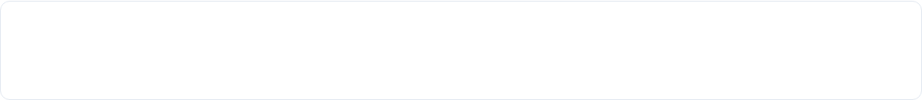





SECTION 5 • MODEL SELECTION & GENERALIZATION
Data Splitting: Train, Validate, Test
COMPLETE DATASET (100%)
1. Training Set
2. Validation Set
3. Test Set
Textbook practice problems for learning rules.
Mock exams to choose the best model settings.
Final board exam strictly kept hidden until the end.
Speaker Notes for Teacher: "Use the school analogy: Training set = Class textbook problems. Validation set = Pre-board mock test to adjust preparation. Test set = Final university exam that students have never seen before. Never touch test data during model training!"

Slide 19

SECTION 5 • MODEL SELECTION & GENERALIZATION
K-Fold Cross-Validation (5-Fold Example)
Fold 1:
Fold 2:
Fold 3:
Fold 4:
Fold 5:
Final Score:
Speaker Notes for Teacher: "When dataset size is small, a single split might be biased. So we rotate! In 5-fold cross-validation, data is split into 5 equal parts. In each round, 4 parts train the model and 1 part tests it. We average the 5 scores for a reliable metric."

Slide 20
Unit-I Quick Recap
Key Takeaways for BCA Students
Classroom Presentation Complete • Questions & Answers
Best of luck with Unit-I!

